Slide 1



PROJECT ON
Last Mile Delivery Analysis
A DATABASE USING MYSQL
Presented by
Bhavani Bollepelli

Slide 2
About Me
Bhavani Bollepelli, B.Tech – CSE
Why Data Science?
Data science gives you the ultimate power to predict trends and guide massive choices using everyday data. It has many open roles, high demand, good pay, job flexibility etc..
Work Experience : Fresher
Linkedin Profile
GitHub Profile

Slide 3
Agenda
Objective of the Project
Database Structure
ER Diagram
Key Analysis Questions
Key Insights & Findings
Experience/Challenges
Conclusion

Slide 4
Objective of the Project :
Analyze delivery performance based on delivery status, duration, distance, and attempts.
Evaluate driver and vehicle performance to identify efficient and underperforming resources.
Identify high-performing and problematic delivery zones based on delivery activity and outcomes
Understand customer and order patterns by analyzing customer types, order frequency, and order values.
Generate actionable insights to reduce delivery delays, improve success rates, and increase overall delivery efficiency.

Slide 5
Database Structure :
This project contains 5 interrelated tables:
Customers
Orders
Drivers
Vehicles
Deliveries
These tables are connected using Primary Keys and Foreign Keys to maintain relational database integrity.

Slide 6
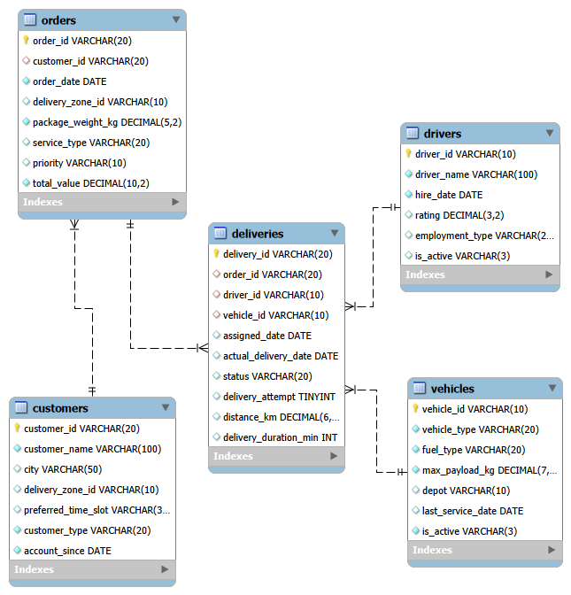
ER Diagram

Slide 7

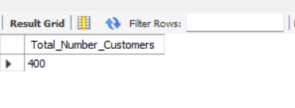
Basic Analysis / Data Exploration
What is the total number of customers?
Query :
Output :
The query identifies the total number of customers available in the customer data.
The total customer count helps understand the overall customer base in the delivery system.

Slide 8


What is the total number of orders?
Query :
Output :
The query identifies the total number of orders available in the orders data.
The total order count (COUNT(order_id)) helps understand the overall order volume in the delivery system.

Slide 9
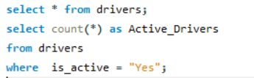

How many drivers are currently active?
Query:
Output:
The query identifies the total number of active drivers available in the drivers data.
The active driver count (driver_id) helps understand the available driving workforce in the delivery system.

Slide 10
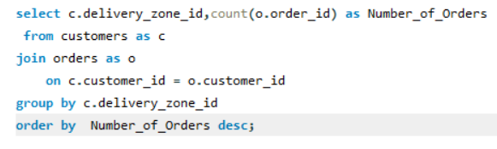
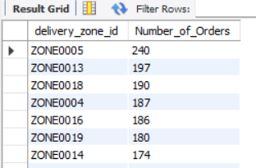
Understand Delivery Demand
Compare the number of orders across delivery zones.
Query:
Output:

Slide 11
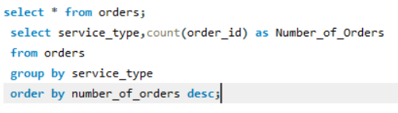
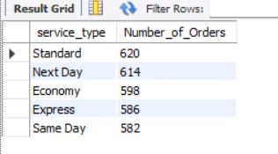
Compare orders across different service types.
Query:
Output:
The query identifies the number of orders for each service type available in the orders data.
The service-wise order count (service_type) helps understand the most commonly used delivery services in the delivery system.

Slide 12

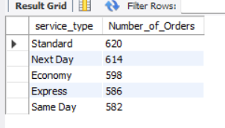
Compare orders based on priority.
Query:
Output:
The query identifies the number of orders for each priority level by counting order_id in the orders data.
The priority-wise order count (COUNT(order_id)) helps understand the distribution of orders across different priority levels.

Slide 13
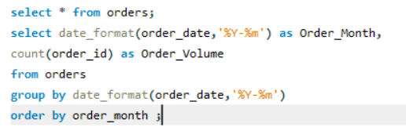
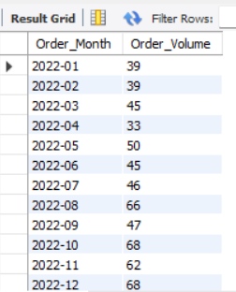
Examine how order volume changes over time.
Query:
Output:
The query identifies the monthly order volume by grouping orders based on the order_date.
The monthly order volume (COUNT(order_id)) helps understand order
trends and changes in demand over time.

Slide 14
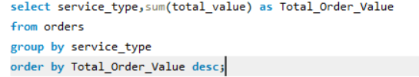
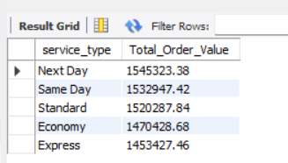
Look at order value across different groups.
Query:
Output:
The query calculates the total order value for each service type by summing the total_value from the orders data.
The service-wise total order value (SUM(total_value)) helps understand which service types contribute the highest order value in the delivery system.

Slide 15
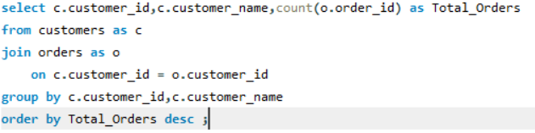
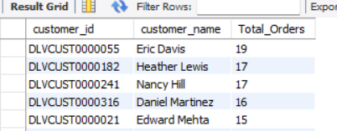
Understand Customer Order Behaviour
Compare customers based on the number of orders they place.
Query:
Output:
The query identifies the total number of orders placed by each customer by joining customer and order data.
The customer-wise order count (COUNT(order_id)) helps understand customer ordering patterns and identify high-order customers.

Slide 16
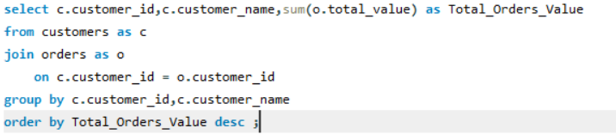
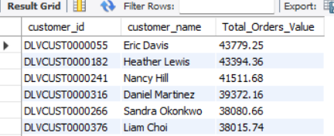
Identify customers with higher total order value.
Query:
Output:
The query calculates the total order value for each customer by joining customer and order data.
The customer-wise total order value (SUM(total_value)) helps understand
customer spending patterns and identify high-value customers.

Slide 17

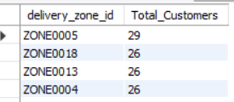
Compare customer activity across delivery zones.
Query:
Output:
he query identifies the total number of customers in each delivery zone by grouping customers based on their delivery_zone_id.
The zone-wise customer count (COUNT(customer_id)) helps understand customer distribution across different delivery zones.

Slide 18


Look at differences between business and individual customers.
Query:
Output:
The query identifies the total number of customers for each customer type by grouping customers based on customer_type.
The customer-type count (COUNT(*)) helps understand the distribution of customers across different customer types.

Slide 19
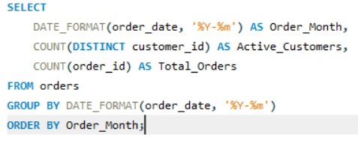
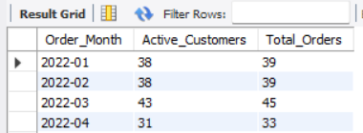
Examine customer ordering patterns over time.
Query:
Output:
The query identifies the number of active customers and total orders for each month by grouping the orders based on the order_date.
The monthly Active_Customers (COUNT(DISTINCT customer_id)) and Total_Orders (COUNT(order_id)) help understand customer activity and order volume trends over time.

Slide 20
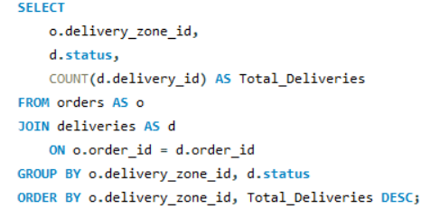
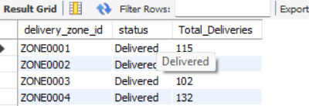
Evaluate Delivery Performance
Compare delivery outcomes across different zones (zone information is on the orders table, so you will need to connect orders and deliveries).
Query:
Output:
The query identifies the number of deliveries for each status within each delivery zone by joining orders and deliveries data.
The zone-wise delivery count (COUNT(delivery_id)) helps understand delivery outcomes and performance across different delivery zones.

Slide 21

Examine delivery duration.
Query:
Output:
The query calculates the average delivery duration of all deliveries available in the deliveries data.
The average delivery duration (AVG(delivery_duration_min)) helps understand the typical time taken to complete a delivery.

Slide 22
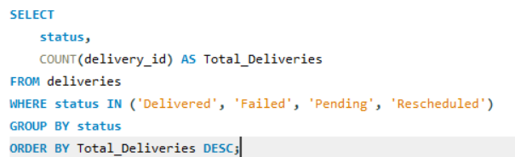

Compare delivery outcomes by status (Delivered, Failed, Pending, Rescheduled) — these are not a simple success/failure split, so consider what each status actually represents.
Query:
Output:
The query identifies the total number of deliveries for each delivery status by grouping the deliveries based on status.
The status-wise delivery count (COUNT(delivery_id)) helps understand the distribution of deliveries across different delivery outcomes.

Slide 23
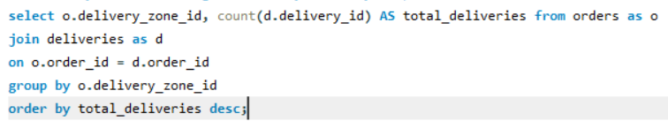
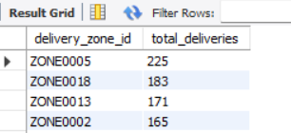
Identify areas with higher delivery activity or poorer outcomes.
Query:
Output:
The query identifies the total number of deliveries for each delivery zone by joining orders and deliveries data.
The zone-wise delivery count (COUNT(delivery_id)) helps understand the delivery distribution and activity across different delivery zones.

Slide 24
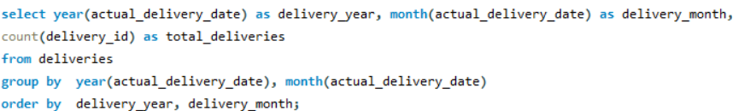
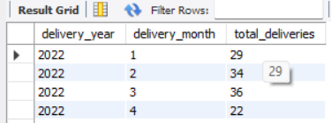
Compare delivery performance over time.
Query:
Output:
The query identifies the total number of deliveries for each month and year by grouping deliveries based on the actual_delivery_date.
The monthly delivery count (COUNT(delivery_id)) helps understand delivery volume trends and changes in delivery activity over time.

Slide 25
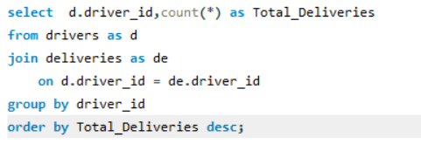
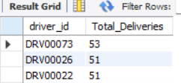
Understand Driver and Vehicle Performance
Compare the number of deliveries handled by drivers.
Query:
Output:

Slide 26
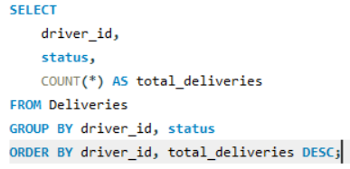
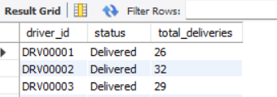
Compare driver performance across delivery outcomes.
Query:
Output:
The query identifies the number of deliveries for each status handled by each driver using the deliveries data.
The driver-wise status count (COUNT(*)) helps compare delivery outcomes across different drivers and understand their delivery performance.

Slide 27

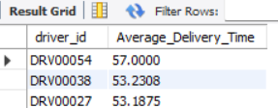
Examine delivery duration across drivers.
Query:
Output:
The query calculates the average delivery time for each driver by grouping deliveries based on driver_id.
The driver-wise average delivery time (AVG(delivery_duration_min)) helps understand delivery time performance across different drivers.

Slide 28
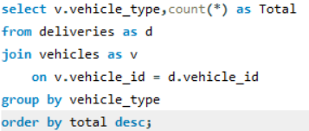
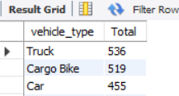
Compare vehicle usage across different vehicle types.
Query:
Output:
The query identifies the total number of deliveries handled by each vehicle type by joining deliveries and vehicles data.
The vehicle-wise delivery count (COUNT(*)) helps understand vehicle usage and delivery activity across different vehicle types.

Slide 29

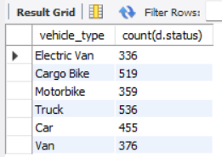
Look at delivery performance across different vehicles.
Query:
Output:
The query identifies the total number of deliveries for each vehicle type by joining deliveries and vehicles data.
The vehicle-wise delivery count (COUNT(status)) helps understand the delivery activity across different vehicle types

Slide 30

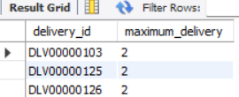
Identify Delivery Problems
Examine which deliveries required multiple attempts before succeeding.
Query:
Output:
The query identifies the delivered orders that required more than one delivery attempt by filtering the deliveries with status = "Delivered".
The delivery attempt count (MAX(delivery_attempt)) helps understand repeat delivery attempts required before successfully completing a delivery.

Slide 31
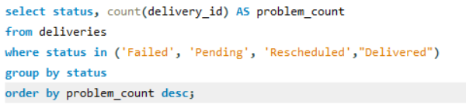

Identify common delivery statuses and problem patterns.
Query:
Output:
The query identifies the total number of deliveries for each delivery status — Failed, Pending, Rescheduled, and Delivered.
The status-wise delivery count (COUNT(delivery_id)) helps understand the distribution of completed and unresolved delivery outcomes in the delivery system.

Slide 32
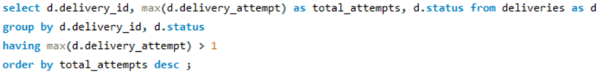
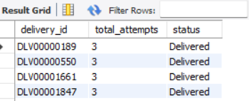
Compare delivery performance for orders with multiple attempts.
Query:
Output:
The query identifies the deliveries that required more than one delivery attempt by grouping records based on delivery_id and status.
The maximum delivery attempt (MAX(delivery_attempt)) helps understand deliveries that required repeated attempts and their final delivery status.

Slide 33
Key Insights & Findings
Identified customer ordering patterns and repeat customers.
Analyzed delivery performance and multiple delivery attempts.
Found problematic zones and delivery issues affecting operations.
Compared business vs. individual customers based on order activity.
Used SQL analysis to identify patterns that can support better business decisions.

Slide 34
Challenges / Experiences:
Learned real-time database design
Worked with multiple related tables
Practiced SQL joins and aggregate queries
Creating correct foreign key relationships
Maintaining data consistency
Writing complex JOIN queries
Managing date formats correctly
These challenges were solved using Primary Keys, Foreign Keys, JOIN operations, GROUP BY, SUM(), AVG(), and COUNT() functions.

Slide 35
Conclusion :
Successfully designed and implemented a Last Mile Delivery Management System using MySQL.
Managed five interrelated tables for customers, orders, drivers, vehicles, and deliveries using Primary Keys and Foreign Keys.
Used SQL queries, JOIN operations, GROUP BY, and aggregate functions such as COUNT(), SUM(), and AVG() to analyze delivery data.
Generated meaningful insights into order volume, customer patterns, delivery outcomes, driver performance, vehicle usage, and delivery zone activity.
Improved understanding of relational database design, data relationships, SQL-based analysis, and real-world delivery operations.
“This project helped me understand how SQL can be used to analyze real-world delivery data and generate meaningful business insights.”

Slide 36
Thank
You

